Slide 1
SOLVOYO CASE STUDY
Solved by Can Umur Akman

Slide 2
Preliminary Observations
Only 2021.
Open date ranges from year 2006 to 2021.
Close date columns include many null entries. In fact, 99% of the entries take NULL value.
Revenue ranges from 243,876 to 0.
Average price ranges from 0 to 45,5.
Number of stores are 304. For a histogram, it would be suitable to use 5 to 10 many bins (one-dimensional clusters), grouped by their revenue or average price or sales quantity or option capacity or date of order. To incorporate all of these, we need higher dimensions.
Option Capacities are exceeded numerous times. These surpluses are substantial as well.

Slide 3
Preliminary Observations
The total revenues for stores are clustered around 100 million to 200 million.
Assumption: Grouping total revenues that are within an interval of 50 million $ is an appropriate approach.
→ The corresponding frequency histogram looks like a normal distribution with a small variance

Slide 4
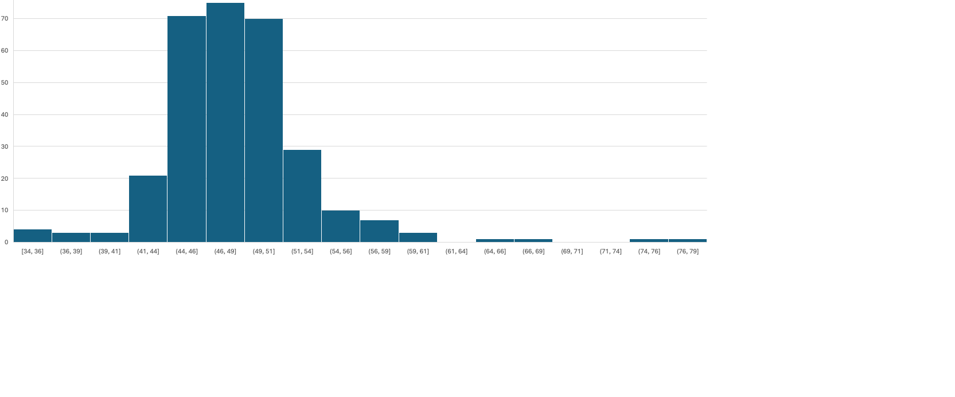
Preliminary Observations
Frequency histogram of the average of the average prices for each store
Cluster within the interval [41, 54]. → 266 values; The rest → 34 values
Opinion: The deviations in average prices are not very high.

Slide 5
Methodology Selection & Further Analysis of Data
Average additional sales that exceed the capacity of each store
Sales Quantity, and either Revenue or Average Price Note: Revenue = Average Price x Sales Quantity
Seasonality effects?
Correlation between quantity ordered and prices?
1) Pooled Case = 0,12
2) Store-specific Case → Capturing “store-effects” (and also “quarter-effects”)
Selection: 1) 91st Store = -0,18, 2) 481st Store = -0,26, 3) 139th Store = -0,20 ← Assumption: Representative
“Pooled” Case not a good representative
Store-specific Case → Little negative correlation between Sales Quantity and Average Price
The demand is not very sensitive to price changes / price elasticity of quantity demanded (i.e., Sales Quantity) is low
Limitation: Correlation only captures linear relationships & does not indicate any direction of causality.
Regression Analysis for causality & Nonlinear Methods for nonlinear relationships

Slide 6
Methodology Selection & Further Analysis of Data
Quarterly seasonality
Swimsuits, ice cream, boots
Quarterly AvgPrice and SalesQty (of previous 3 stores)
Q4 prices >>
Q2 or Q3 Sales Quantities > Q1 or Q4
Opinion: Open Date of the store not informative.
Informative: Location, district population…
91
481
139
AvgPrice Q1 Average | 37,87404
AvgPrice Q2 Average | 37,970917
AvgPrice Q3 Average | 38,410891
AvgPrice Q4 Average | 65,565201
SalesQty Q1 Average | 3236,25
SalesQty Q2 Average | 4950,7273
SalesQty Q3 Average | 5443,5385
SalesQty Q4 Average | 3565,2857
AvgPrice Q1 Average | 34,84277608
AvgPrice Q2 Average | 36,03085258
AvgPrice Q3 Average | 33,52163365
AvgPrice Q4 Average | 58,54897266
SalesQty Q1 Average | 1295,833333
SalesQty Q2 Average | 2120,727273
SalesQty Q3 Average | 2852,846154
SalesQty Q4 Average | 1625,642857
AvgPrice Q1 Average | 43,48415481
AvgPrice Q2 Average | 39,94775747
AvgPrice Q3 Average | 46,26430352
AvgPrice Q4 Average | 75,43650784
SalesQty Q1 Average | 4234,166667
SalesQty Q2 Average | 7192,416667
SalesQty Q3 Average | 10620,07692
SalesQty Q4 Average | 5288,071429

Slide 7
Methodology Selection & Further Analysis of Data
Important Indicators
The Revenue data instead of separately including Sales Quantity and Average Price due to price inelasticity of demand.
The Average Excesses on Option Capacities for each store
The Quarter of the orders to capture seasonality

Slide 8
Clustering Model
298 stores
2021
Features:
Average Revenue
Average Excesses
Average Quarter of the Year (i.e., the fractional quarter value that receives orders most frequently). → when a store is visited more frequently → may account for higher/lower Average Revenues or Average Excesses.
MODEL
Centroid-based clustering: K-Means Algorithm
One downside: K is a parameter.
To pick the right K(s): Silhouette Analysis → K=3 Highest Score & K=5 3rd Highest Score.
Consider both scenarios.

Slide 11
Clustering Model
The plots show how the clustering is done as per the “Average Revenue” and “Average Excess” features.
NOTE: No information in regards to how “Average Quarter” feature has been utilized in the clustering.
→Wrong (at the moment) : K=3 is more suitable than K=5 or vice versa.
→ Further analysis, such as other clustering evaluation metrics may be helpful on deciding the optimal K.

Slide 12
Policy Implications
Different set of policies for each cluster:
Number of staff
Option Capacity (surplus/shortage),
Pricing of products
Sale quantities (e.g., backlogging demand to smooth # sales through time)
can be adjusted.
Cost reduction & Rise in customer satisfaction & Higher revenue & Higher utilization of resources (e.g., capacity of the stores)
More prepared for the demand fluctuations caused by seasonality effects.

Slide 13
REFERENCES
Thompson, J. (2022, September 7). Choosing the right clustering algorithm for your dataset. KDnuggets. https://www.kdnuggets.com/2019/10/right-clustering-algorithm.html
Kmeans. scikit. https://scikit-learn.org/stable/modules/generated/sklearn.cluster.KMeans.html

